Slide 1
OTP VERIFICATION SYSTEM

Slide 2
INDEX
SL NO | TOPIC
1 | INTRODUCTION
2 | OBJECTIVE
3 | PROJECT DIAGRAM
5 | PROJECT REQUIREMENTS
6 | HARDWARE AND SOFTWARE REQUIREMENTS
7 | CODING VIDEO
8 | OUTPUT SCREENSHOT
9 | CONCLUSION

Slide 3
INTRODUCTION
Security and privacy most important for an individual in software domain. So, we should access to only the authorized individual.authentication is necessary.That how otp helps. It is fixed length random number generated and sent to the individual verification the perosn enter for verification
The purpose of this method involves:
OTP generation
Send otp to respective emails
Otp validation ( Maximum 3 attempts)
Send verification gmails
Problem statement: You are tasked with developing an OTP (One-Time Password) verification system in Python. The system should generate a 6-digit OTP and send it to the user's email address for verification. Upon receiving the OTP, the user should enter it into the system for validation. If the entered OTP matches the generated OTP, access should be granted; otherwise, access should be denied.

Slide 4
OBJECTIVE
This project involves generating a 6-digit one-time password (OTP) and sending it via email to authenticate users. The OTP is generated randomly using Python libraries and sent to the provided email address. The user must then enter the OTP they receive to gain access.

Slide 5
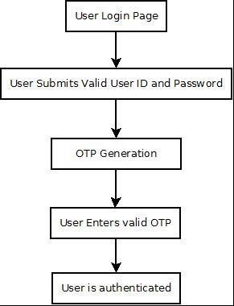
PROJECT DIAGRAM

Slide 6
PROJECT REQUIREMENTS
Implement a function to generate a 6-digit OTP randomly.
Develop a function to simulate sending the OTP to the user's email address.
Create a function to prompt the user to enter the OTP received in their email.
Implement a function to verify if the entered OTP matches the generated OTP.
Ensure proper error handling and user-friendly prompts throughout the system.
Allow the user to retry OTP entry in case of incorrect input

Slide 7
HARDWARE AND SOFTWARE REQUIREMENTS
HARDWARE TOOLS | MINIMUM REQUIREMENTS
Processor | Dual core or above
Hard disk | 4 GB
Ram | 8GB
Monitor | 17”” coloured
Mouse | Optical
keyboard | 122
SOFTWARE TOOLS | MINIMUM REQUIREMENTS
Platform | Windows/linux
Os | wWndows/mac
Technology | Machine learning- python
Script language | Python
Ide | Pycharm

Slide 8
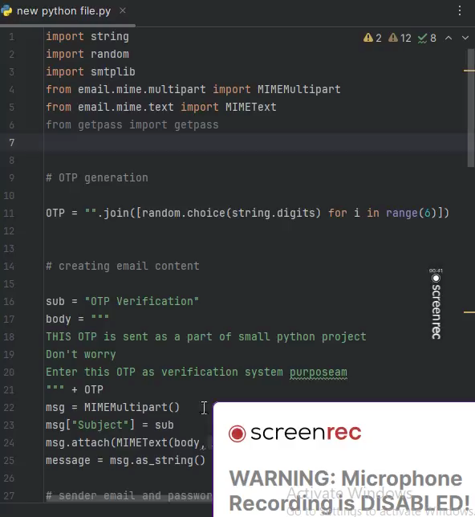
CODING VIDEO

Slide 9
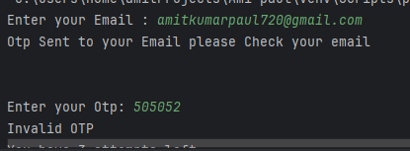
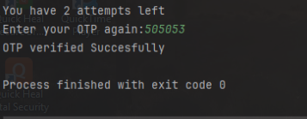
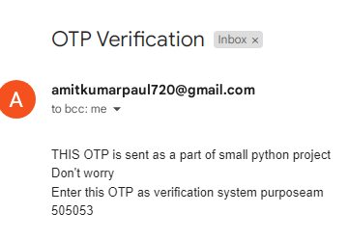
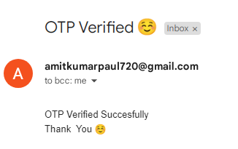
OUTPUT SCREENSHOT

Slide 10
conclusion
OTP verification is one of the ways to ensure the identity of a person during transactions, registration, etc. OTP verification provides additional security along with the static password method. It also helps to reduce cyber crimes as the expiry time of OTP is just a few minutes. OTP verification is a very simple and feasible solution for any business or own private purpose.

